Slide 1
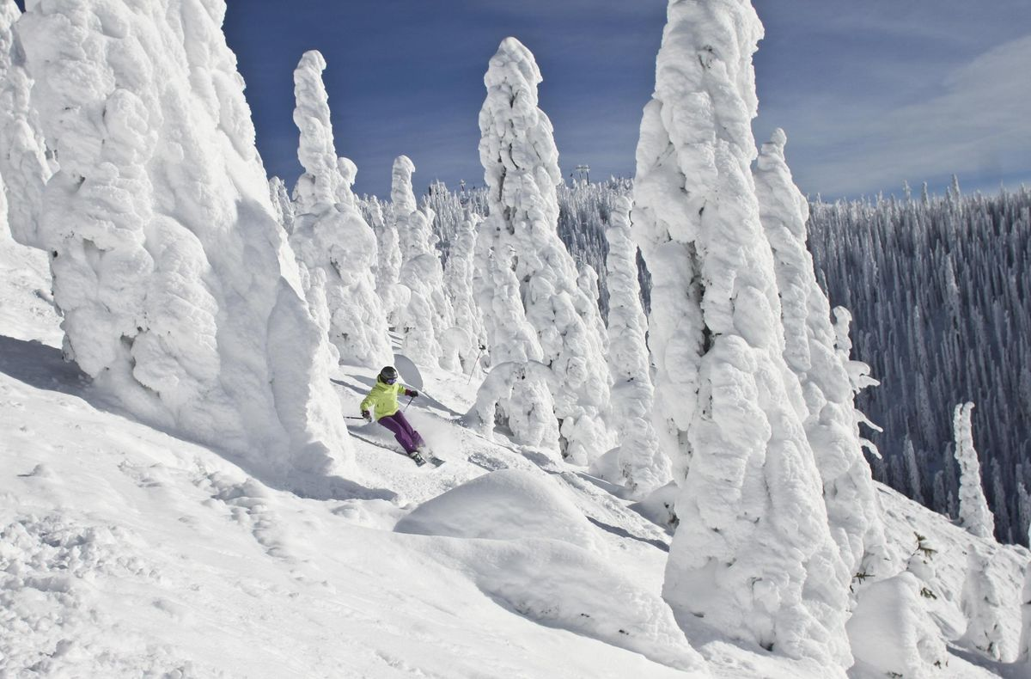
Tech design
Big Mountain Resort Pricing Model Presentation
-Rutvi Gohel

Slide 2

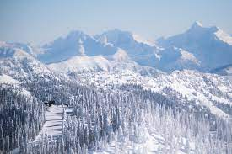
Problem Statement
What opportunities exist for Big Mountain Resort to effectively develop and implement a new pricing strategy that can maximize capitalization in their facilities investments to offset their recent additional operating cost by $1,540,000 this season.
Resort Story
Big Mountain Resort offers spectacular views of Glacier National Park and Flathead National Forest, with access to 105 trails. Every year about 350,000 people ski or snowboard at Big Mountain. The business expressed a desire for some guidance on how to select a better value for their ticket price. by considering number of changes hoping to reduce cost without reducing ticket price or increasing ticket price.

Slide 3
Resort’s current Pricing Strategy
For Big Mountain Resort to base their pricing mainly on just the market average won’t be enough to maximize their capitalization investment and can’t be sustainable to gain an edge over the competition.
Recommendations
Our Model suggests that Mountain Resort’s ticket price is lower than the predicted model by 16.31%, and the resort have many potential scenarios for either cutting costs by closing runs or increasing ticket price by increasing vertical drop, adding acres snow making or increasing the longest run.
Increasing the vertical drop by 150 ft would increase the ticket price by 10.44% from $81 to $89.46, resulting in revenue increase by $14,811,594.
Adding 2 acres of snow making would increase the ticket price by 12% from $81 to $90.75, resulting in revenue increase by $17,068,841.

Slide 4
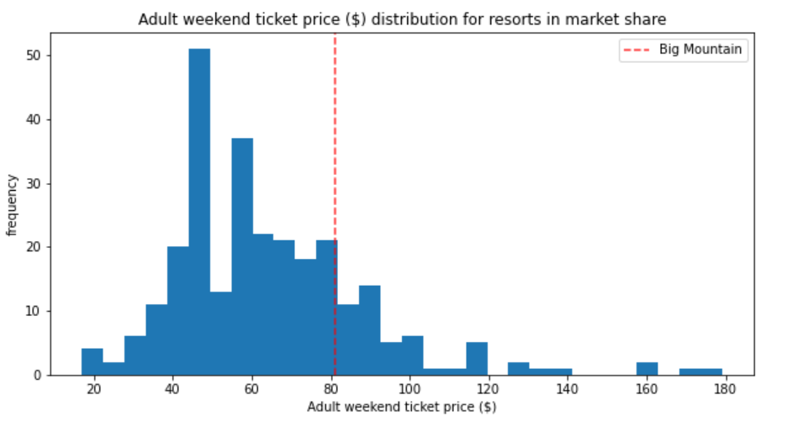
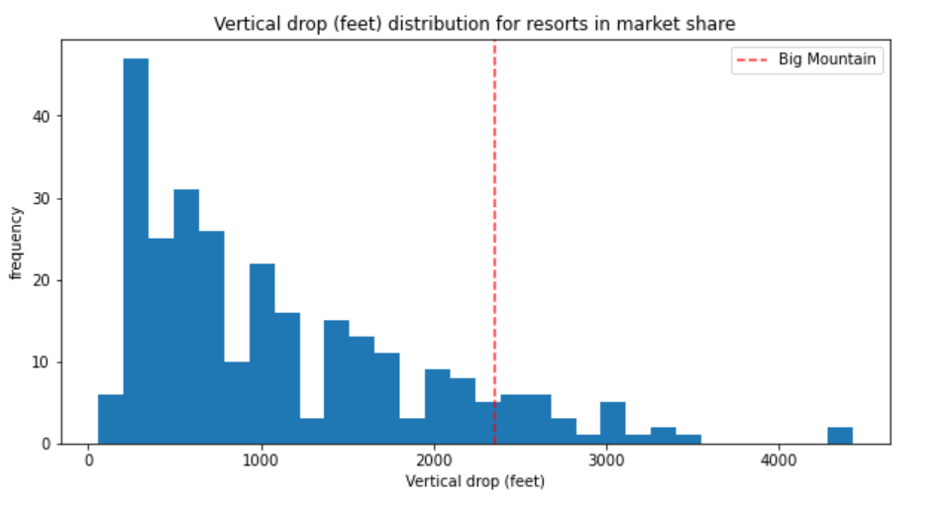
Big Mountain is doing well for vertical drop but there are still quite a few resorts with a greater drops.
Big Mountain’s Ticket Price compared to other resorts’ price.

Slide 5
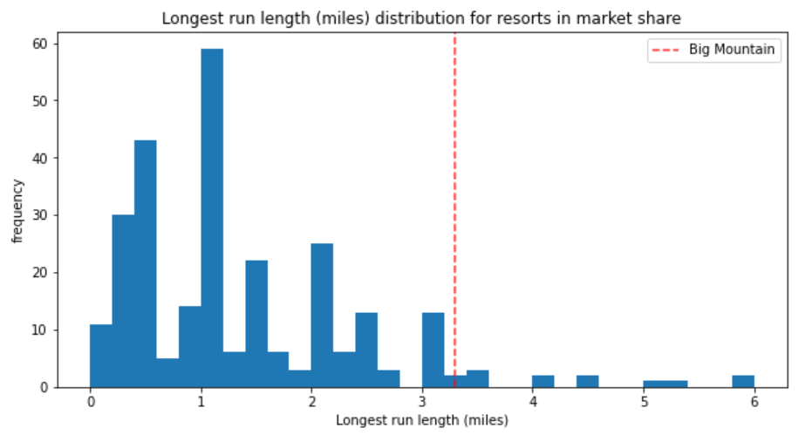
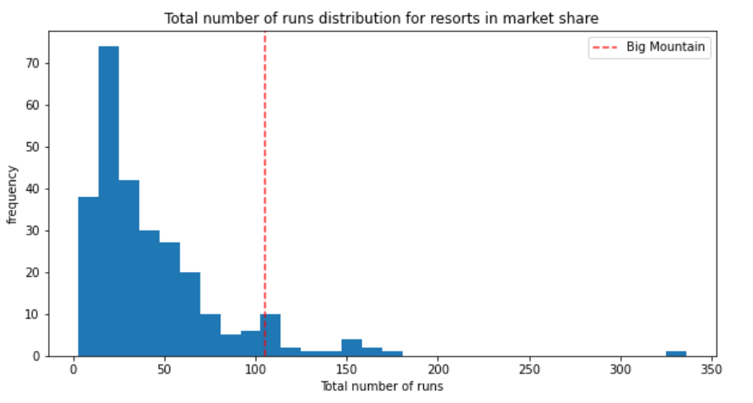
Big Mountain has one of the longest runs. Although it is just over half the length of the longest, the longer ones are rare.
Big Mountain compares well for the number of runs. There are some resorts with more, but not many.

Slide 6
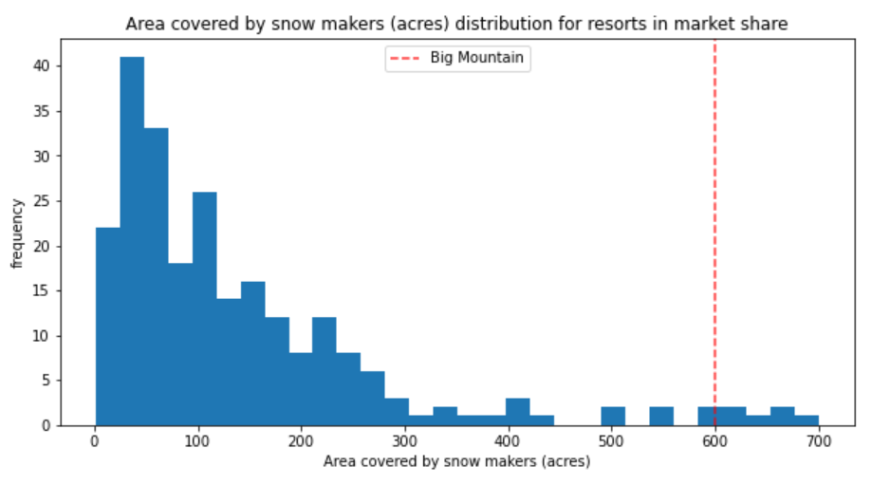
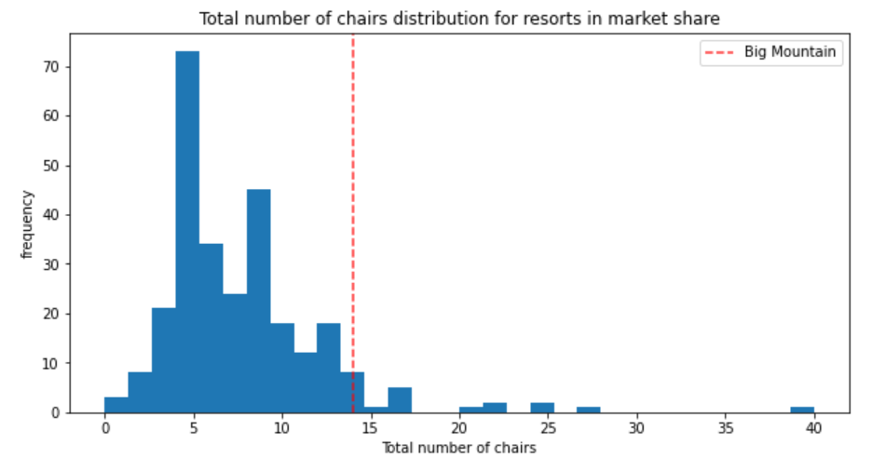
Big Mountain is very high up the league table of snow making area.
Big Mountain has amongst the highest number of total chairs, resorts with more appear to be outliers.

Slide 7

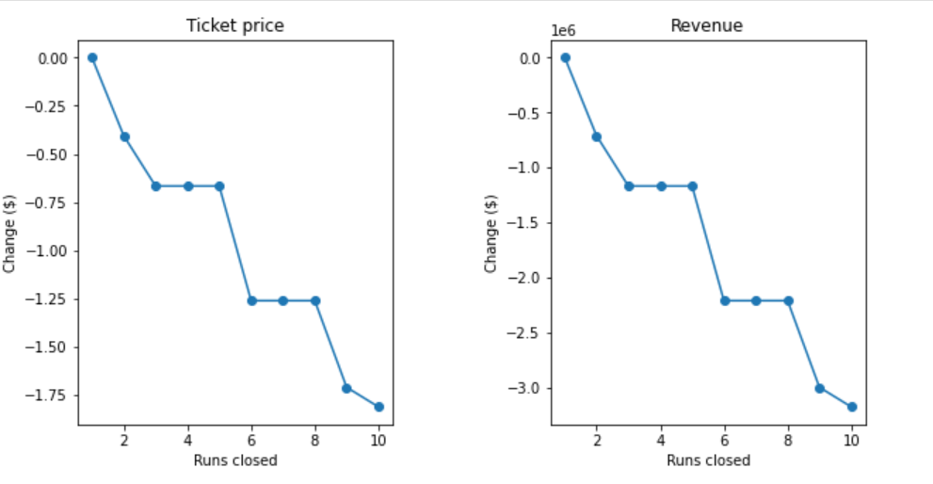
Closing 10 runs vs Ticket price & Revenue
Big Mountain Resort has been reviewing a potential scenario for cutting costs by permanently closing 10 of the least used runs.
When it comes to closing 10 used Runs, our Model predicted the following:
Closing one run will have no impact on Ticket price or revenue.
Closing 2 runs reduce support for ticket price and so revenue by $0.4 and $750,000 respectively.
Closing 3 runs, it seems they may as well close 4 or 5 as there’s same loss in ticket price and revenue by $0.67 and $1.250M respectively.
Closing 10 runs reduce support for ticket price and so revenue by $1.71 and $3M respectively.
Because we don’t know the operating cost per used run, we can’t determine how much cost saving will be offset the loss in revenue after closing more than one run.

Slide 8
Conclusion:
After applying our Model for ski resort ticket price and leverage it to explore Big Mountain Resort’s potential scenarios for increasing revenue, we can conclude that:
The best scenario where we managed to gain the highest revenue increase possible was by increasing the vertical drop by 150 ft, adding one Chair Lift, adding one run and adding 2 acres of snow making cover. This scenario has increased ticket price by 12% from $81 to $90.75, resulting in a bottom-line increase by $15,528,841, after deducting operating costs = $1.54M.
Due to lack of data in regards of operating cost per used run and weekdays ticket price, our model cannot recommend closing used runs or implementing a dynamic ticket pricing.

Slide 9

Thank You
RUTVIMGOHEL@GMAIL.com

